Slide 1
Python Workshop
Session 5

Slide 2
Covering today
Nesting
Loops
Lists
Matrices
NumPy Cheatsheet

Slide 3
Nesting
Def = Placing a structure inside another to be able to achieve complex operations
Why?
Efficiency
Allows handling of multi-dimensional data (tables or grids)
Data Manipulation
Essential for tasks like iterating through matrixes, processing hierarchical data, ect..
Example of nesting
Lists within lists: [[1,2],[3,4],[5,6]]

Slide 4
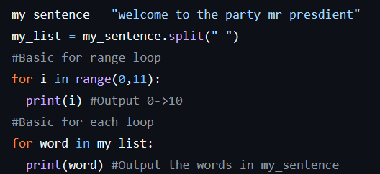
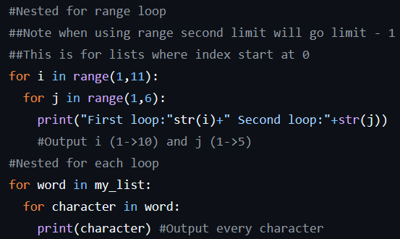
Nesting in terms of loops

Slide 5
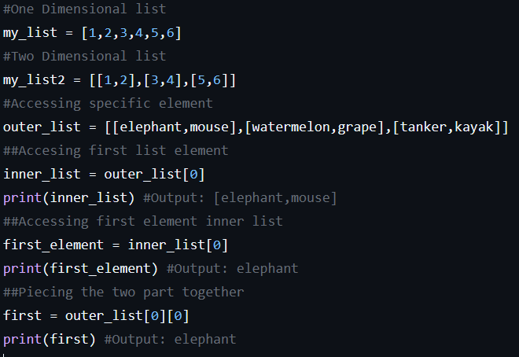
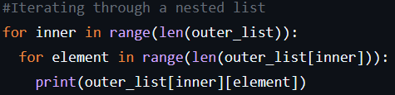
Nesting in terms of lists

Slide 6
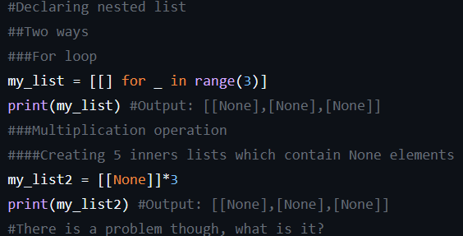
Troubleshooting Nesting

Slide 7
Matrices
Def = Special two-dimensional list where each inner one-dimensional list are same length
Numbers arranged in rows and columns
Why
Efficient storage for multi-dimensional data
Enables multiplication operations like addition, subtract, multiplication and more

Slide 8
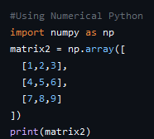
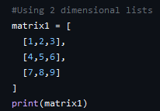
Ways to create Matrices

Slide 9
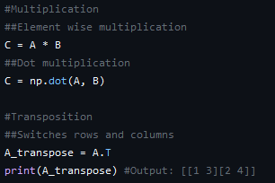
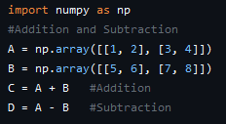
Basic Matrix operations

Slide 10
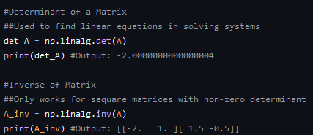
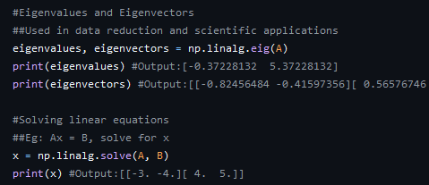
Advanced Matrix Operations with NumPy

Slide 11
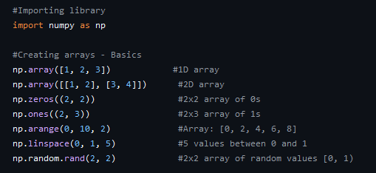
NumPy Cheat sheet
Really good website = https://speedsheet.io/s/numpy

Slide 12
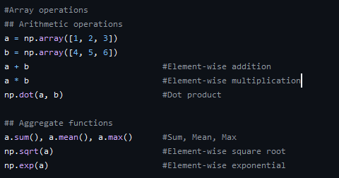
NumPy Cheat Sheet Continued

Slide 13
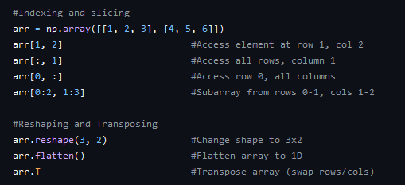
NumPy Cheat Sheet Continued

Slide 14
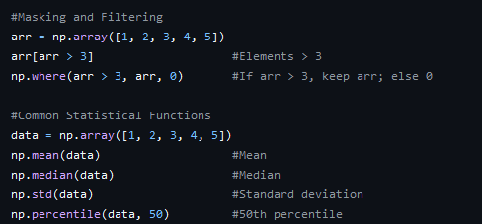
NumPy Cheat Sheet Continued

